Slide 1
Basic Questions

Slide 2
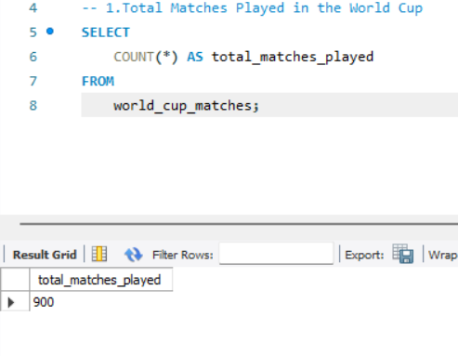
1.Total Matches Played in the World Cup

Slide 3
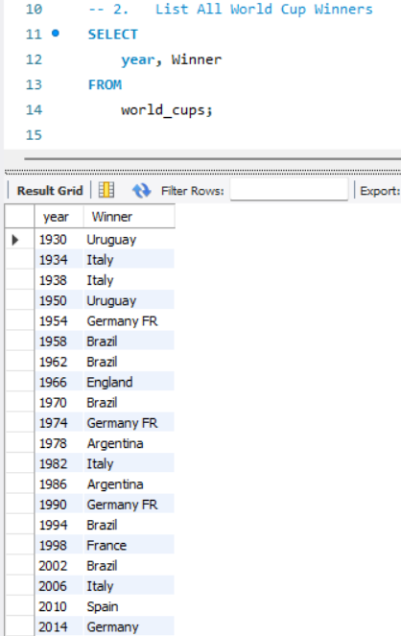
2.List All World Cup Winners

Slide 4
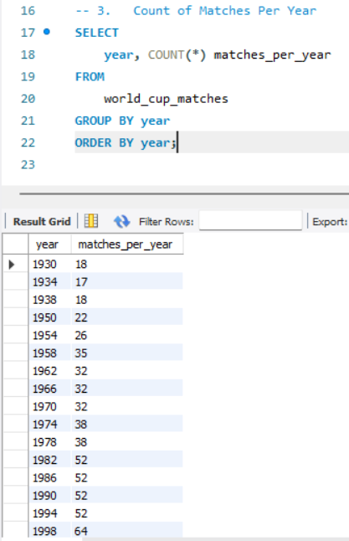
3.Count of Matches Per Year

Slide 5
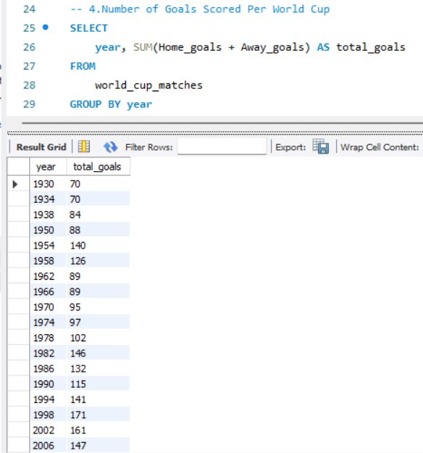
4.Number of Goals Scored Per World Cup

Slide 6
Intermediate Questions

Slide 7
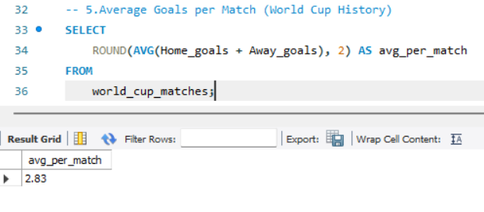
5.Average Goals per Match (World Cup History

Slide 8
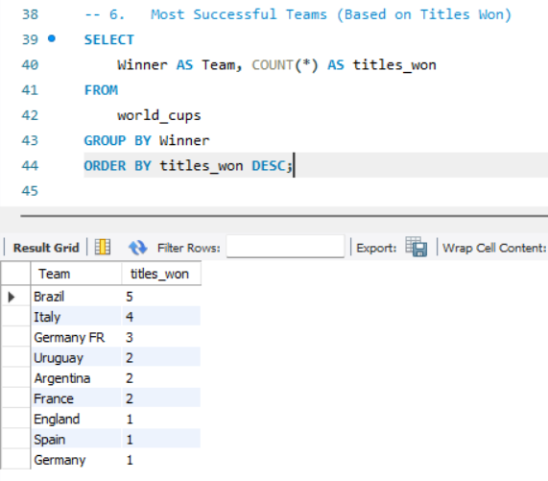
6.Most Successful Teams (Based on Titles Won)

Slide 9
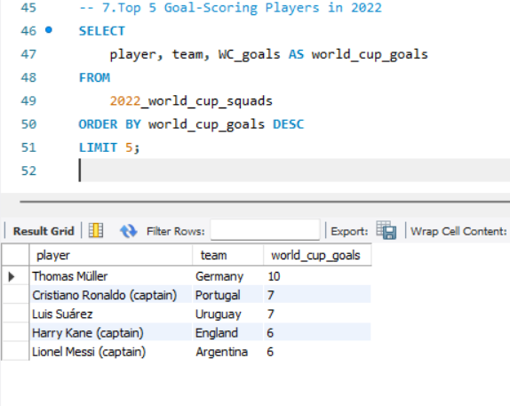
7.Top 5 Goal-Scoring Players in 2022

Slide 10
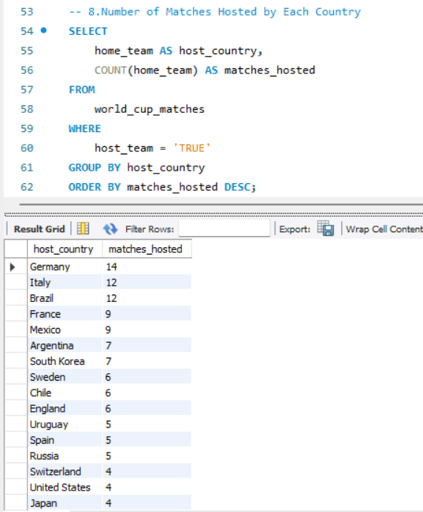
8.Number of Matches Hosted by Each Country

Slide 11
Advanced

Slide 12
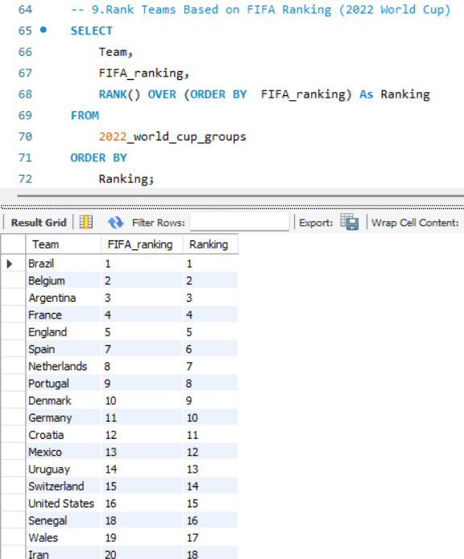
9.Rank Teams Based on FIFA Ranking (2022 World Cup)

Slide 13
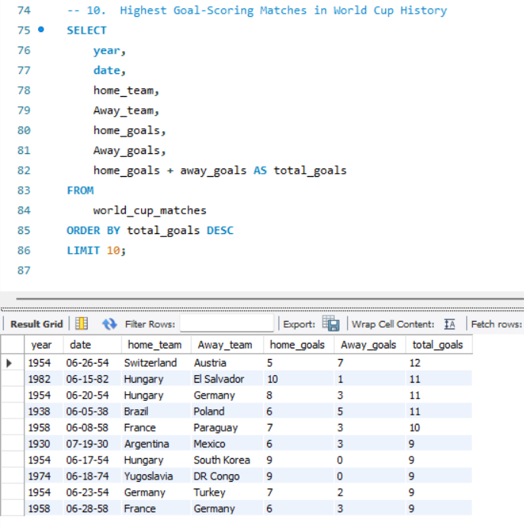
10.Highest Goal-Scoring Matches in World Cup History

Slide 14
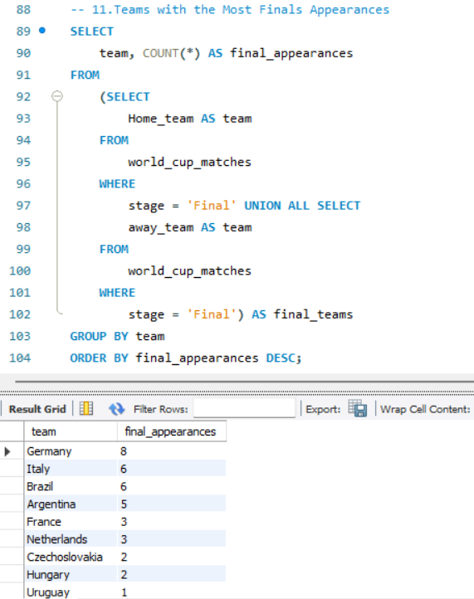
11.Teams with the Most Finals Appearances

Slide 15
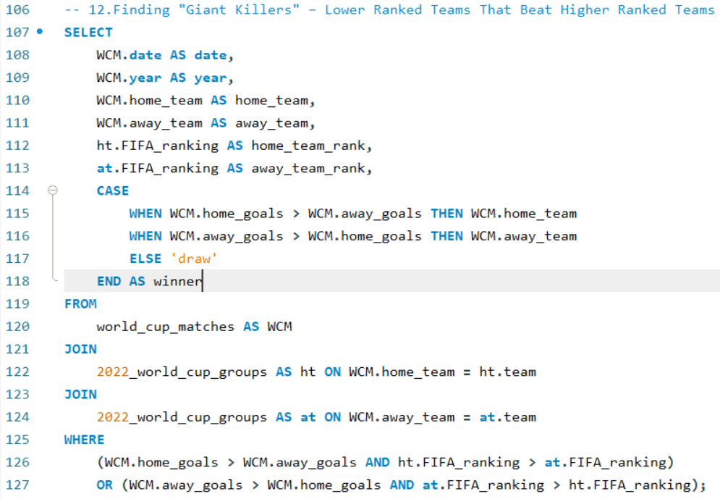
12.Finding "Giant Killers" – Lower Ranked Teams That Beat Higher Ranked Teams

Slide 16
